Slide 1

Academic Advisor
Dr. Roberto
ENEL 645 PROJECT
Midterm Presentation
Team Members
Aaron Joseph
Do Trong Anh
Alan Joseph
Bright Anorchie
March 16, 2021

Slide 2
Fire and Smoke Detection using Convolutional Neural Networks
Challenges
Dataset
Dataset
Image Variance: Color, Texture, Contrast, etc.
Limited Scope & Accuracy of Physical Solutions such as sensors.
Acquired from Kaggle
3000 Images in Total
2700 – Train Images & 300 – Test Images
Train set contains 900 each of Fire, Smoke, Default images
Test set contains 100 each of Fire, Smoke, Default images
Our Goal
A visual based solution using deep convolutional neural networks with high accuracy to detect smoke & fire in video footage.

Slide 3
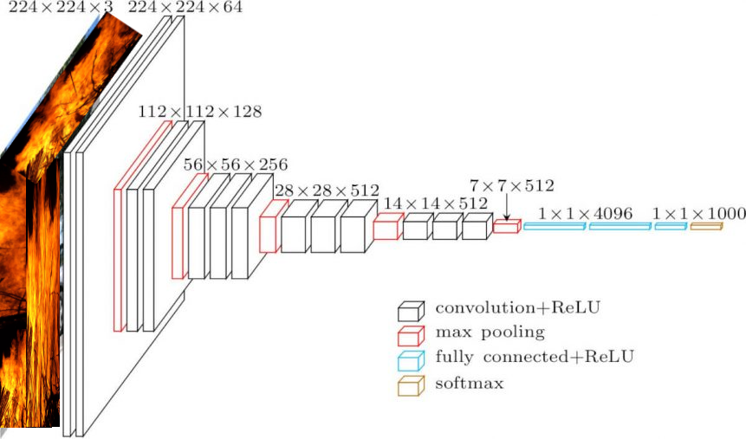
Fire and Smoke Detection using Convolutional Neural Networks
Methodology
Import Packages: Numpy, matplotlib, Tensorflow packages, etc.
Import & Read Images. Used ImageDataGenerator (Keras)
Model used – VGG-16 (pre-trained with weights)
Used Adam optimizer
Trained for 300 epochs
Representative VGG-16 model used to train our data.

Slide 4
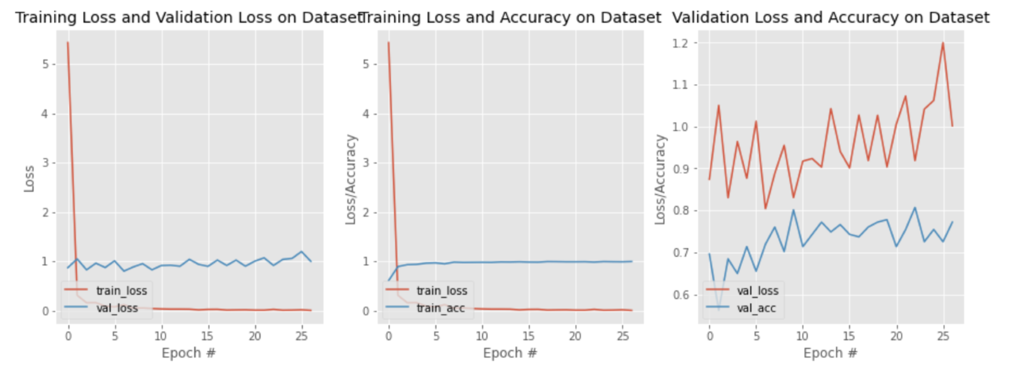
Preliminary Results
Two 4096 Dense layers (ReLU), one 1000 Dense layer (ReLU) and one Softmax layer

Slide 5
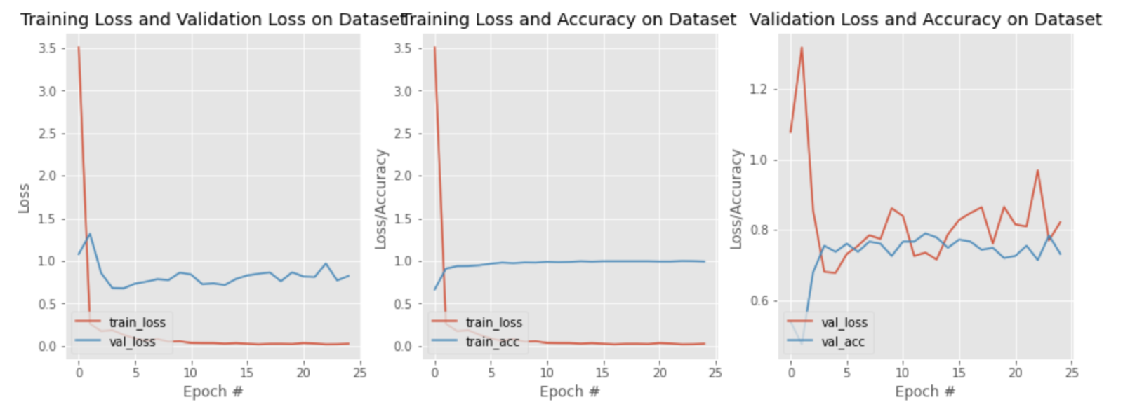
Preliminary Results
One 4096 Dense layers, one 1000 Dense layer and one Softmax layer

Slide 6
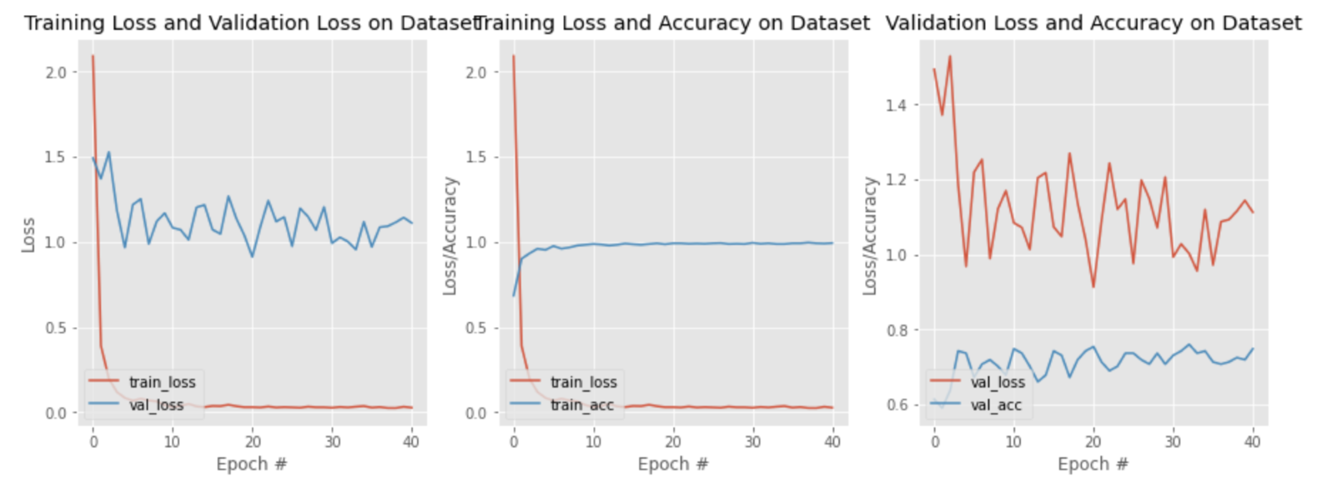
Preliminary Results
One 1000 Dense layer and one Softmax layer

Slide 7
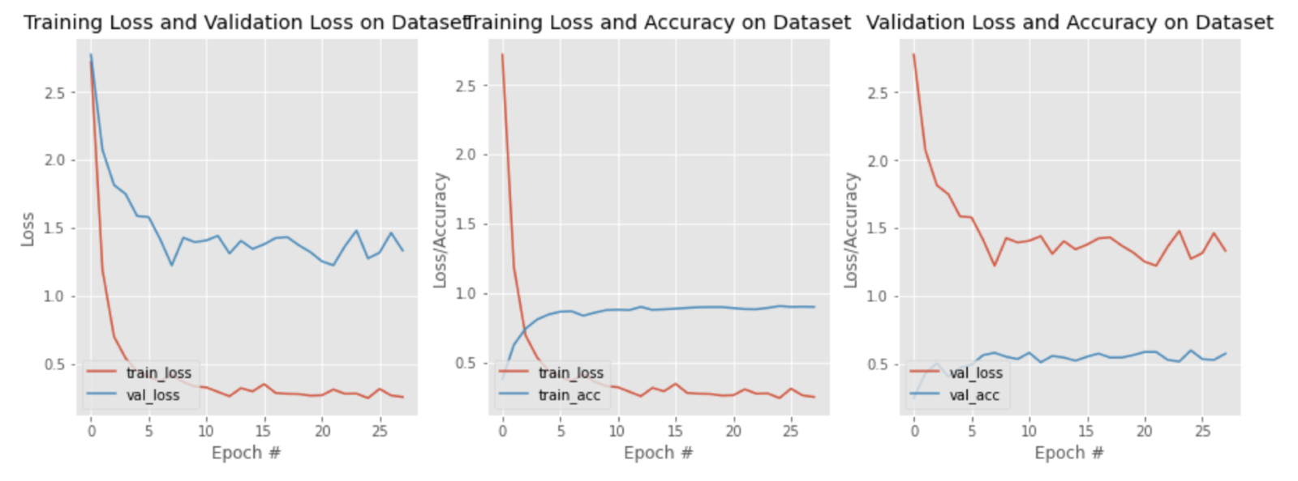
Preliminary Results
Only the Softmax layer

Slide 8
Fire and Smoke Detection using Convolutional Neural Networks
Future Steps
Acquiring more data to further expand and train our model.
Further rescaling and transformation of our dataset
Using U-net model against noisy data, etc.
Experiment with exceptionally large and exceedingly small learning rates or try out a learning rate that decreases over epochs.
Experiment with different activation functions

Slide 9
ENEL 645 PROJECT
Thank You
Midterm Presentation

